Slide 1
Reputation Verification System Basics
Slides illustrate the conceptual paper and have been expanded by Craig Calcaterra

Slide 2
Is Reputation Foundational for DAOs ?
Depends on Priors – Foundational Perspectives
Problem with Web of Trust: If good interaction online then both parties gain reputation, bad experience then they lose reputation. Use sockpuppets – sell to yourself and say good things about yourself. All sockpuppets gain reputation. Use sockpuppet reputation to cheat the DAO to lie and steal money from the DAO.
Once smart contract valuable enough, can only trust system to the degree that it costs more to cheat than to support.
Reputation allows for second order economic effects that make the system more attack resistant
Reputation enables true decentralization

Slide 3
Reputation Validation DAO Basics:
A dynamic list of system-generated sub-tokens, representing reputation/expertise in any domain.
The forum of expertises. For each expertise, there is a linked list of posts, where each list has a sub-token assigned to it, based on its root post, called the expertise tag, or expertise. Each post can include opinions, evidence of work, evidence of expertise, policies, and contract templates. A post is a trivial smart contract on the (Ethereum) blockchain, typically a short text post. The forum is housed on a blockchain to allow eternal verification and review of the reputation created in each post.
The bench of experts. Experts are anonymous users who stake their respective sub-tokens to answer validation requests or proclaim their availability for off-platform / DAO work.
The validation pool. Experts may stake their expertise-specific tokens in order to validate or invalidate posts through a betting pool. This is used to answer validation requests, set precedents, promote specialization and proficiency. The validation pool is the mechanism which creates and distributes reputation.

Slide 4
DAO Architecture Basics:
Necessity #1: Forum. Evidence of all work needs to be posted to the blockchain for eternal review.
Necessity #2: Validation pool. In a decentralized environment consisting of potentially anonymous actors, the only fair way to assign power is to allow all users to judge the value of contributions democratically.
Necessity #3: Reputation token minting. All new repute tokens are minted in proportion to fees, and staked 50/50 in a validation pool, for and against a post.
Necessity #4: Reputational salary. All fees should be shared with the entire group of token holders (the bench of experts) relative to their holdings
Necessity #5: Precedent System: Review through references. Finally, each new post has the opportunity to reference older posts, changing the value of previous posts depending on how important users perceive the precedent for the system.

Slide 5
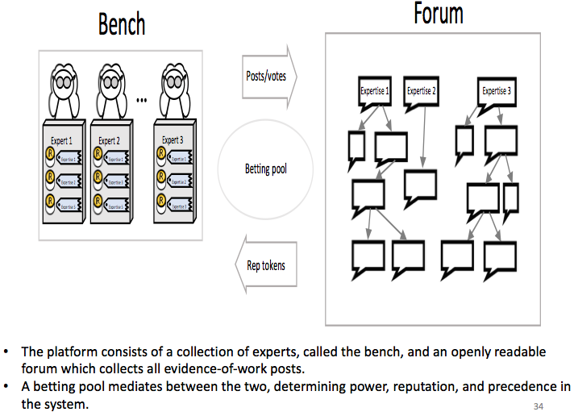
DAO Elements and Interaction

Slide 6
The Forum as a Weighted Directed Acyclic Graph (WDAG)
Domain specific expertise
Eternal record in the forum
The tokens must have a foundational meaning
Tokens enter fairly
All decisions are made by weighted votes
All fees sent to the platform are shared proportionally in reputation-weighted salaries
The opportunity for review of reputation
Notes:
Problem #4. How specifically do you provide meaningful and secure reputation?
Solution: Six components.
Domain specific expertise. Semada mints separate types of reputation tokens for every separate type of expertise or DAO. Experts in producing 2 different widgets should not have interchangeable reputation tokens.
The tokens must have a foundational meaning. Semada mints tokens only in proportion to the fees that are sent to the platform when a member does off-chain work. An action that creates a larger fee, creates more reputation. ***Cartoon A
For security, the tokens must enter fairly. Tokens are distributed only after they are staked for and against a post and the bench of experts validates them through a betting pool. ***Cartoon B
For security from Sybil attacks, all decisions are made by weighted votes. ***Cartoon C1,2,3
All power is determined by sem holdings and all fees sent to the platform are shared proportionally in sem-weighted salaries. Since sem acquisition becomes the primary motivation instead of immediately fungible currency, the incentive is to improve the platform instead of exploiting platform-damaging arbitrage opportunities. ***Cartoon D
The opportunity for review of reputation by referencing past actions
prevents long-term gaming strategies from the threat of loss of long-term valuable reputation
motivates long-term platform improvement and development from the opportunity for revaluating such actions once they are proven to be successful.
***WDAG figure

Slide 7
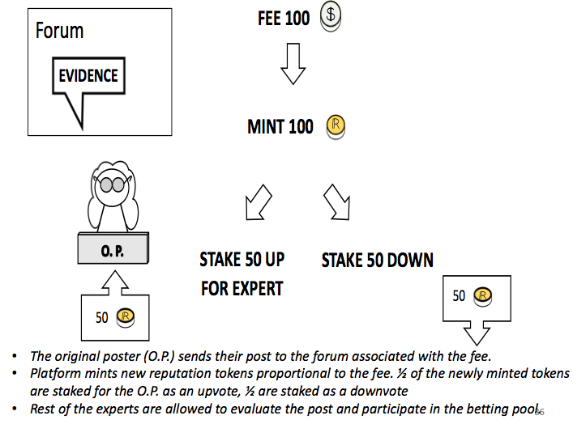
Engaging with the DAO

Slide 8
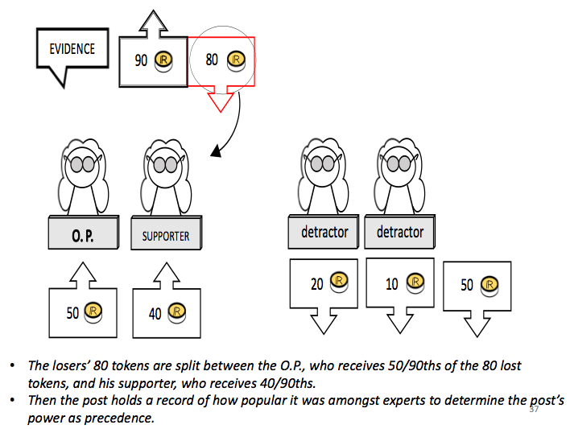
Validation Pool Outcomes
In this example the upvotes on the evidence-of-work post win with 90 tokens against 80 staked as downvotes. The original poster’s (O.P.) newly minted 50 added to a supporter’s 40, against the 50 newly minted downvote tokens added to 30 tokens cast as downvotes by detractors. The losers’ 80 tokens are split between the O.P., who receives 50/90 of the 80 lost tokens, and his supporter, who receives 40/90. Then the post holds a record of how popular it was amongst experts to determine the post’s power as precedence.

Slide 9
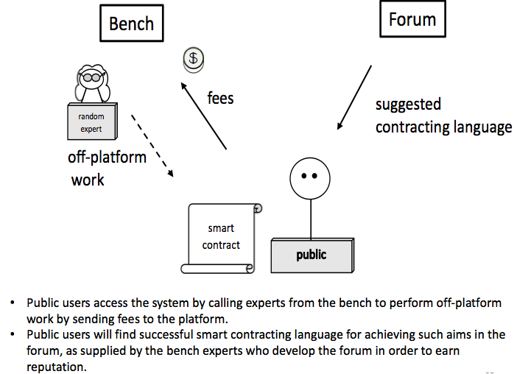

Slide 10
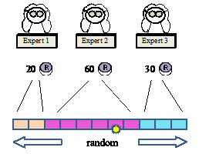
Random Weighted Expert Selection for DAO Work Proposals
Random selection of experts is decided by relative weight of reputation. Before a smart contract is engaged, experts have the opportunity to stake reputation tokens to signal their availability for work. These availability stakes will be added as the chosen experts’ upvote bet on their evidence-of-work post. In this example the yellow star stops randomly along the bar, but is most likely to stop on the 2nd expert.

Slide 11
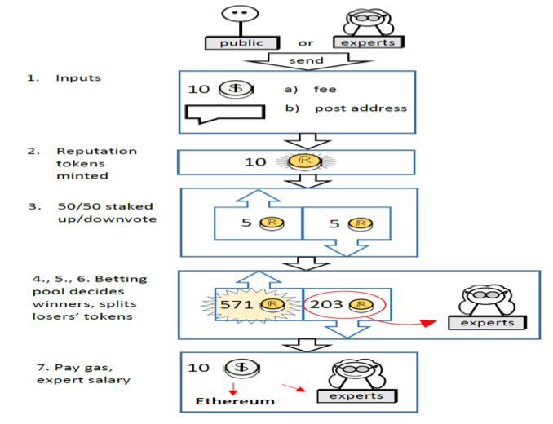

Slide 12
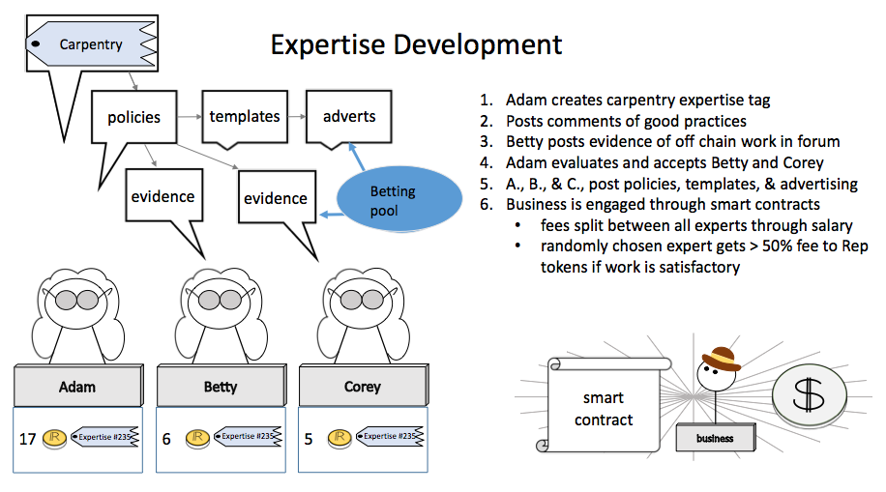

Slide 13
Validation Pool
Betting pool on evidence of work post
.
Evidence
of work
availability stake & evidence of work post
smart contract fee collected by system
reputation tokens equal to fee are created
½ Rep tokens stake added to expert’s stake & ½ Rep tokens stake added to system downvotes
comments made on post
upvotes & downvotes with repute stakes
winners split loser’s stakes
availability stake 10
Expert

Slide 14
Validation Pool
Betting pool on evidence of work post
.
Evidence
of work
availability stake & evidence of work post
smart contract fee collected by system
reputation tokens equal to fee are created
½ Rep tokens stake added to expert’s stake & ½ Rep tokens stake added to system downvotes
comments made on post
upvotes & downvotes with repute stakes
winners split loser’s stakes
10
0
O. P.
10

Slide 15
Validation Pool
Betting pool on evidence of work post
.
Evidence
of work
availability stake & evidence of work post
smart contract fee collected by system
reputation tokens equal to fee are created
½ Rep tokens stake added to expert’s stake & ½ Rep tokens stake added to system downvotes
comments made on post
upvotes & downvotes with repute stakes
winners split loser’s stakes
10
0
fee 100
O. P.
10

Slide 16
Validation Pool
Betting pool on evidence of work post
.
Evidence
of work
availability stake & evidence of work post
smart contract fee collected by system
reputation tokens equal to fee are created
½ Rep tokens stake added to expert’s stake & ½ Rep tokens stake added to system downvotes
comments made on post
upvotes & downvotes with repute stakes
winners split loser’s stakes
10
0
fee 100
100
O. P.
10

Slide 17
Validation Pool
Betting pool on evidence of work post
.
Evidence
of work
availability stake & evidence of work post
smart contract fee collected by system
reputation tokens equal to fee are created
½ Rep tokens stake added to expert’s stake & ½ Rep tokens stake added to system downvotes
comments made on post
upvotes & downvotes with repute stakes
winners split loser’s stakes
60
50
fee 100
100
50
O. P.
50
10

Slide 18
Validation Pool
Betting pool on evidence of work post
Evidence
of work
availability stake & evidence of work post
smart contract fee collected by system
reputation tokens equal to fee are created
½ Rep tokens stake added to expert’s stake & ½ Rep tokens stake added to system downvotes
comments made on post
upvotes & downvotes with repute stakes
winners split loser’s stakes
60
50
O. P.
50
60

Slide 19
Validation Pool
Betting pool on evidence of work post
Evidence
of work
availability stake & evidence of work post
smart contract fee collected by system
reputation tokens equal to fee are created
½ Rep tokens stake added to expert’s stake & ½ Rep tokens stake added to system downvotes
comments made on post
upvotes & downvotes with repute stakes
winners split loser’s stakes
60
50
O. P.
50
60

Slide 20
Validation Pool
Betting pool on evidence of work post
Evidence
of work
availability stake & evidence of work post
smart contract fee collected by system
reputation tokens equal to fee are created
½ Rep tokens stake added to expert’s stake & ½ Rep tokens stake added to system downvotes
comments made on post
upvotes & downvotes with repute stakes
winners split loser’s stakes
63
50
O. P.
Supporter
50
60
3

Slide 21
Validation Pool
Betting pool on evidence of work post
Evidence
of work
availability stake & evidence of work post
smart contract fee collected by system
reputation tokens equal to fee are created
½ Rep tokens stake added to expert’s stake & ½ Rep tokens stake added to system downvotes
comments made on post
upvotes & downvotes with repute stakes
winners split loser’s stakes
67
50
O. P.
Supporter
Supporter
50
60
3
4

Slide 22
Validation Pool
Betting pool on evidence of work post
Evidence
of work
availability stake & evidence of work post
smart contract fee collected by system
reputation tokens equal to fee are created
½ Rep tokens stake added to expert’s stake & ½ Rep tokens stake added to system downvotes
comments made on post
upvotes & downvotes with repute stakes
winners split loser’s stakes
67
52
O. P.
Supporter
Supporter
Detractor
2
50
60
3
4

Slide 23
Validation Pool
Betting pool on evidence of work post
Evidence
of work
availability stake & evidence of work post
smart contract fee collected by system
reputation tokens equal to fee are created
½ Rep tokens stake added to expert’s stake & ½ Rep tokens stake added to system downvotes
comments made on post
upvotes & downvotes with repute stakes
winners split loser’s stakes
67
58
O. P.
Supporter
Supporter
Detractor
Detractor
2
6
50
60
3
4

Slide 24
Validation Pool
Betting pool on evidence of work post
Evidence
of work
availability stake & evidence of work post
smart contract fee collected by system
reputation tokens equal to fee are created
½ Rep tokens stake added to expert’s stake & ½ Rep tokens stake added to system downvotes
comments made on post
upvotes & downvotes with repute stakes
winners split loser’s stakes
67
59
O. P.
Supporter
Supporter
Detractor
Detractor
Detractor
2
6
1
50
60
3
4

Slide 25
Validation Pool
Betting pool on evidence of work post
Evidence
of work
availability stake & evidence of work post
smart contract fee collected by system
reputation tokens equal to fee are created
½ Rep tokens stake added to expert’s stake & ½ Rep tokens stake added to system downvotes
comments made on post
upvotes & downvotes with repute stakes
winners split loser’s stakes
67
59
O. P.
Supporter
Supporter
Detractor
Detractor
Detractor
2
6
1
50
60
3
4

Slide 26
Validation Pool
Betting pool on evidence of work post
Evidence
of work
availability stake & evidence of work post
smart contract fee collected by system
reputation tokens equal to fee are created
½ Rep tokens stake added to expert’s stake & ½ Rep tokens stake added to system downvotes
comments made on post
upvotes & downvotes with repute stakes
winners split loser’s stakes
67
59
O. P.
Supporter
Supporter
Detractor
Detractor
Detractor
2
6
1
50
60
3
4

Slide 27
Validation Pool
Betting pool on evidence of work post
Evidence
of work
availability stake & evidence of work post
smart contract fee collected by system
reputation tokens equal to fee are created
½ Rep tokens stake added to expert’s stake & ½ Rep tokens stake added to system downvotes
comments made on post
upvotes & downvotes with repute stakes
winners split loser’s stakes
67
59
O. P.
Supporter
Supporter
Detractor
Detractor
Detractor
0
0
0
0
95
13
18

Slide 28
The Forum as a Weighted Directed Acyclic Graph
(WDAG)

Slide 29
vertex/post
edge/reference
graph with cycles
DAG

Slide 30

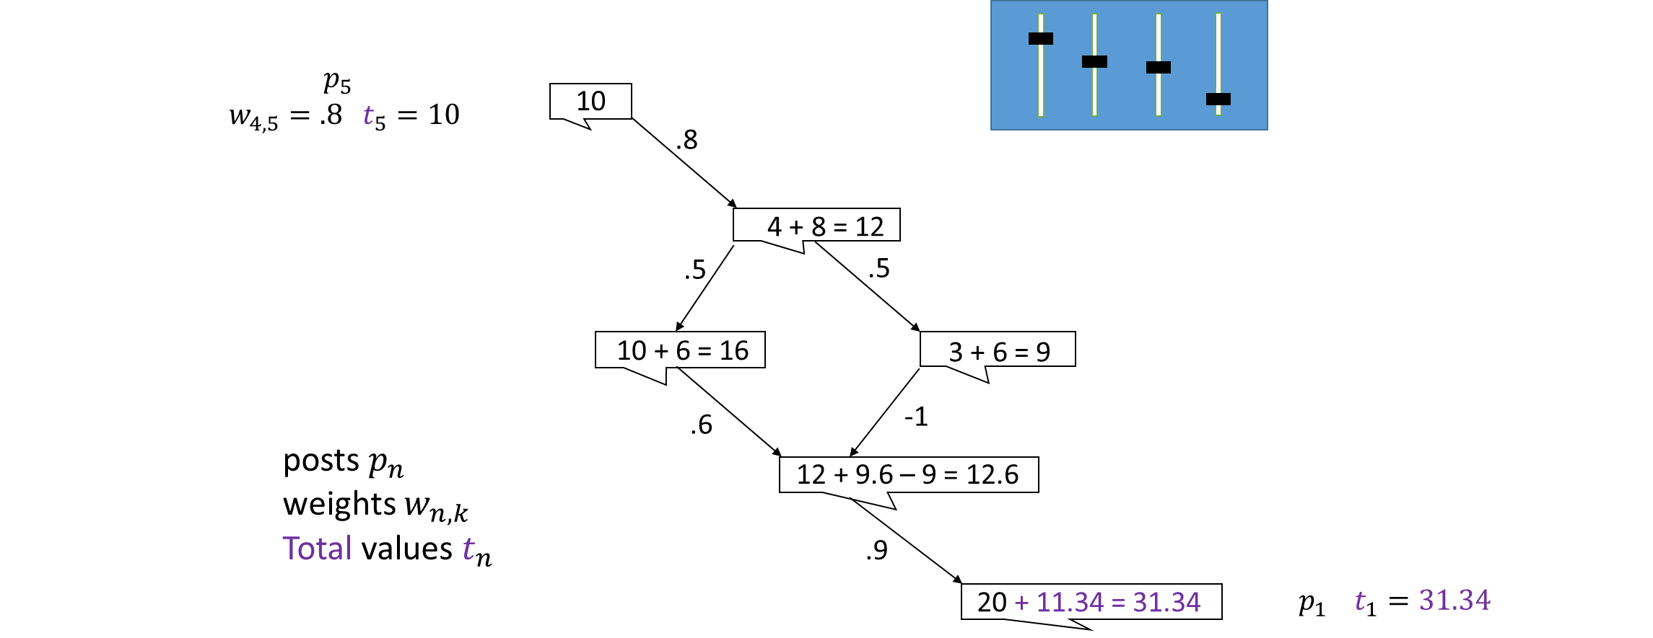

PROBLEMS & SOLUTIONS
Governing DAOs
18 basic parameters deciding how and when reputation tokens are minted and distributed and revaluated in review
CONFIDENTIALITY NOTICE: Not for public distribution.
For use by the recipients only. Document contains proprietary information which may not be disclosed to any third party without the express written consent of Semada Inc. Copyright 2018 Semada Inc.
Notes:
Problem #5. How can you organize DAOs? to reflect the great diversity of business applications… providing services, products, collaborations between companies, IoT, oracles, dispute resolution…? How can we achieve decentralized governance?
Reputation is the key ingredient in business and in good governance. Organizing interested groups of experts who wish to collaborate to provide products and services is a matter of creating the right incentives by finding the right protocols for distributing power and rewarding members with profits. We’ve identified 18 basic parameters in Semada core, for deciding how and when reputation tokens are minted and distributed and revaluated in review. These parameters can be adjusted to match the values and goals of any given organization. An analysis of this problem is initiated in ***cite DAO Governance paper. ***add figures showing how changing the parameters (dials) changes the reward structure in the WDAG***
On-chain governance is achieved by moving from legislative governance to regulatory governance in a series of validation pools which establishes a DAO’s acceptance of a new protocol for behavior. This acceptance is measured first by polling the group in loosely-coupled votes where sem tokens cannot be lost to encourage the authentic deliberation that comes from encouraging minority points of view to be voiced. Then consensus is assured by gradually moving to finalizing new protocols with tightly-coupled votes, where sem tokens will be lost if you vote in the minority. ***add figure showing a dial which switches from 0% to 100% tokens staked and 3 experts’ smiles changing from flat to smiley/frowny
These protocols will dictate how each member is expected to act, when doing off-chain work, or when validating the reputation created during off-chain work.

Slide 31
PROBLEMS & SOLUTIONS
Governing DAOs
18 basic parameters deciding how and when reputation tokens are minted and distributed and revaluated in review
Expert
Expert
Expert
CONFIDENTIALITY NOTICE: Not for public distribution.
For use by the recipients only. Document contains proprietary information which may not be disclosed to any third party without the express written consent of Semada Inc. Copyright 2018 Semada Inc.
Notes:
Problem #5. How can you organize DAOs? to reflect the great diversity of business applications… providing services, products, collaborations between companies, IoT, oracles, dispute resolution…? How can we achieve decentralized governance?
Reputation is the key ingredient in business and in good governance. Organizing interested groups of experts who wish to collaborate to provide products and services is a matter of creating the right incentives by finding the right protocols for distributing power and rewarding members with profits. We’ve identified 18 basic parameters in Semada core, for deciding how and when reputation tokens are minted and distributed and revaluated in review. These parameters can be adjusted to match the values and goals of any given organization. An analysis of this problem is initiated in ***cite DAO Governance paper. ***add figures showing how changing the parameters (dials) changes the reward structure in the WDAG***
On-chain governance is achieved by moving from legislative governance to regulatory governance in a series of validation pools which establishes a DAO’s acceptance of a new protocol for behavior. This acceptance is measured first by polling the group in loosely-coupled votes where sem tokens cannot be lost to encourage the authentic deliberation that comes from encouraging minority points of view to be voiced. Then consensus is assured by gradually moving to finalizing new protocols with tightly-coupled votes, where sem tokens will be lost if you vote in the minority. ***add figure showing a dial which switches from 0% to 100% tokens staked and 3 experts’ smiles changing from flat to smiley/frowny
These protocols will dictate how each member is expected to act, when doing off-chain work, or when validating the reputation created during off-chain work.

Slide 32
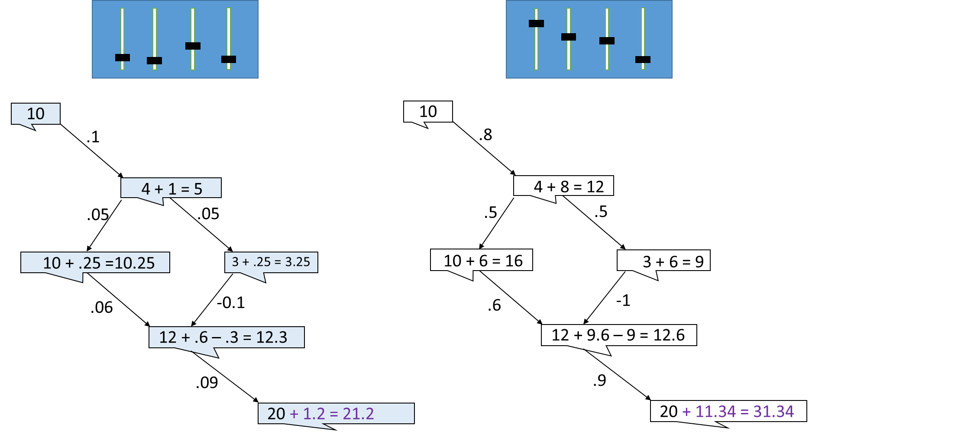
PROBLEMS & SOLUTIONS
Governing DAOs
18 basic parameters deciding how and when reputation tokens are minted and distributed and revaluated in review
Expert
Expert
Expert
CONFIDENTIALITY NOTICE: Not for public distribution.
For use by the recipients only. Document contains proprietary information which may not be disclosed to any third party without the express written consent of Semada Inc. Copyright 2018 Semada Inc.
Notes:
Problem #5. How can you organize DAOs? to reflect the great diversity of business applications… providing services, products, collaborations between companies, IoT, oracles, dispute resolution…? How can we achieve decentralized governance?
Reputation is the key ingredient in business and in good governance. Organizing interested groups of experts who wish to collaborate to provide products and services is a matter of creating the right incentives by finding the right protocols for distributing power and rewarding members with profits. We’ve identified 18 basic parameters in Semada core, for deciding how and when reputation tokens are minted and distributed and revaluated in review. These parameters can be adjusted to match the values and goals of any given organization. An analysis of this problem is initiated in ***cite DAO Governance paper. ***add figures showing how changing the parameters (dials) changes the reward structure in the WDAG***
On-chain governance is achieved by moving from legislative governance to regulatory governance in a series of validation pools which establishes a DAO’s acceptance of a new protocol for behavior. This acceptance is measured first by polling the group in loosely-coupled votes where sem tokens cannot be lost to encourage the authentic deliberation that comes from encouraging minority points of view to be voiced. Then consensus is assured by gradually moving to finalizing new protocols with tightly-coupled votes, where sem tokens will be lost if you vote in the minority. ***add figure showing a dial which switches from 0% to 100% tokens staked and 3 experts’ smiles changing from flat to smiley/frowny
These protocols will dictate how each member is expected to act, when doing off-chain work, or when validating the reputation created during off-chain work.

Slide 33
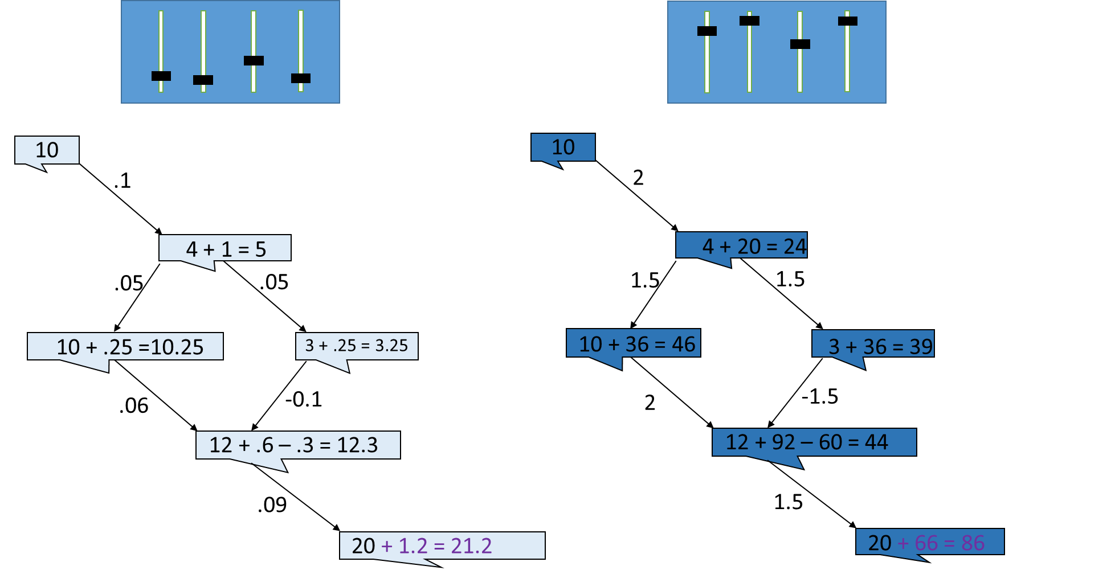
PROBLEMS & SOLUTIONS
Governing DAOs
18 basic parameters deciding how and when reputation tokens are minted and distributed and revaluated in review
Expert
Expert
Expert
CONFIDENTIALITY NOTICE: Not for public distribution.
For use by the recipients only. Document contains proprietary information which may not be disclosed to any third party without the express written consent of Semada Inc. Copyright 2018 Semada Inc.
Notes:
Problem #5. How can you organize DAOs? to reflect the great diversity of business applications… providing services, products, collaborations between companies, IoT, oracles, dispute resolution…? How can we achieve decentralized governance?
Reputation is the key ingredient in business and in good governance. Organizing interested groups of experts who wish to collaborate to provide products and services is a matter of creating the right incentives by finding the right protocols for distributing power and rewarding members with profits. We’ve identified 18 basic parameters in Semada core, for deciding how and when reputation tokens are minted and distributed and revaluated in review. These parameters can be adjusted to match the values and goals of any given organization. An analysis of this problem is initiated in ***cite DAO Governance paper. ***add figures showing how changing the parameters (dials) changes the reward structure in the WDAG***
On-chain governance is achieved by moving from legislative governance to regulatory governance in a series of validation pools which establishes a DAO’s acceptance of a new protocol for behavior. This acceptance is measured first by polling the group in loosely-coupled votes where sem tokens cannot be lost to encourage the authentic deliberation that comes from encouraging minority points of view to be voiced. Then consensus is assured by gradually moving to finalizing new protocols with tightly-coupled votes, where sem tokens will be lost if you vote in the minority. These protocols will dictate how each member is expected to act, when doing off-chain work, or when validating the reputation created during off-chain work.

